Slide 1
Parallel Image Processing and Computer Graphics
(Part-I GPU)
Yanci Zhang

Slide 2
Overview
Motivation: Why GPU?
History of GPU
Stream programming model
GPGPU & GPU computing
Applications:
Computer graphics
Image processing

Slide 3
Why Parallel Computing?
Performance of CPU increased 50% per year from 1986 to 2002
Simply wait for the next generation of CPU in order to obtain increased performance
Single-processor performance improvement slowed down to 20% since 2002
The road to rapidly increasing performance lay in the direction of parallelism
Put multiple processors on a single circuit rather than developing ever-faster monolithic processor

Slide 4
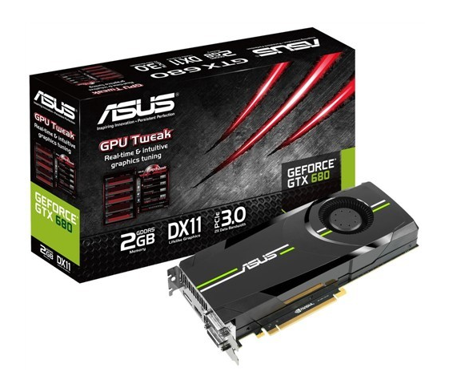
What is GPU
GPU: Graphics Processor Unit
Developed rapidly from being primitive drawing devices to being major computing resources

Slide 5
Motivation
GPU is more powerful than CPU
Computational power: FLOPS (Floating point Operations Per Second)
Parallelism
Bandwidth
High performance growth

Slide 6
Floating Point Calculation
Heavy use of floating point calculation
CPU
Intel Xeon E5-2600: 149.16 GFLOPS
GPU
nVidia GeForce GTX Titan Z: 8.1/2.7 TFLOPS(single/double precision)
Modern GPUs support high precision
32-bit floating point throughout the pipeline
Support double precision

Slide 7
Parallelism
Parallelism: allows simultaneous operations at the same time
CPU
Dual-core, quad-core, six-core
Not adequately exploit parallelism
GPU
GeForce GTX Titan Z: equipped with 5760 cores

Slide 8
Bandwidth
The bandwidth between key components ultimately dictates system performance
CPU
DDR3-2666: 31.6GB/s
GPU
GeForce GTX Titan Z: 384x2 bits, 672GB/s
Notes:
Peak performance of computer systems is often far in excess of actual application performance, due to the memory gap problem, the mismatch of memory and processor performance. In data-intensive applications, the processing elements (PEs) often spend most of the time waiting for data. GPUs have traditionally been optimized for high data throughput, with wide data buses (256 bit) and the latest memory technology (GDDR3).

Slide 9
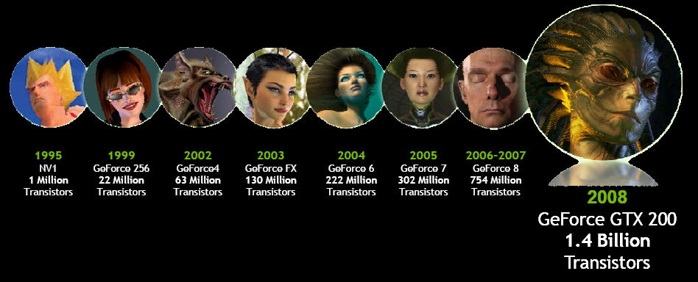
Getting Faster and Faster
CPU
Annual growth ~ 1.5x -> decade growth ~60x
GPU
Annual growth ~2.0x -> decade growth > 1000x
Much faster than Moore’s law
Multi-billion dollar video game market is a pressure cooker that drives innovation

Slide 10
Evolution of Graphics Hardware
Game before 1996: CPU in charge of all computations
The first 3D acceleration card: Voodoo
Start new ear of high-performance and high-quality 3D graphics for gaming
GPU: proposed by nVidia GeForce 256
Introducing hardware transformation and lighting
GPU in charge of graphics computation
PPU: proposed by Ageia
PPU in charge of physical computation
Ageia is took over by nVidia, and PPU is merged to GPU
Future: CPU and GPU merged together? APU

Slide 11


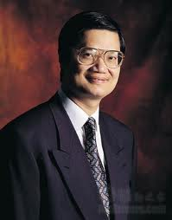
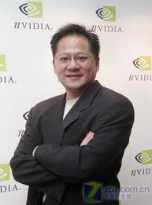
Origin of nVidia and ATI
ATI
Lee Ka Lau, Benny Lau, and Kwok Yuen Ho(何国源) founded ATI in 1985
nVidia
Jen-Hsun Huang(黄仁勋), Chris Malachowsky, Curtis Priem founded nVidia in 1993
Notes:
1950年，何国源出生在广东省新会地区，1962年，上到小学六年级的何国源随母亲来到澳门，第二年到了香港。20岁的何国源只身来到台湾，就读台湾成功大学电子工程系。1974年，何国源大学毕业回到香港，在那里找到了他平生第一份正式工作。 1983年，何国源的一位校友准备移民去加拿大，问他要不要也去看看，何国源说“当然啊”。于是何国源去买了一张旅游机票，怀着送朋友外加旅游的心情踏上了ATI的诞生福地——多伦多。1985年，何国源和另外两名香港移民Benny Lau(产品开发副总裁)和Lee Lau(策略计划副总裁)共同创建的ATI(Array Technology Inc。)公司在多伦多北面的万锦市宣告成立。 成立之初，ATI公司确实没有什么钱，全部资本就是六个创始人共同投资的30万加元。何国源拿出的并不是他的全部积蓄，而只是其中的三分之一。“狡兔三窟”是何国源的做事原则，“三分之一我要留着结婚安家，还有三分之一就留着保险，万一失败了还可以有机会从头再来”。成立第一年，ATI取得960万加元的收入业绩，其中盈利超过160万。第二年，收入已经增加到了3900万，盈利1000多万，在加拿大所有高科技公司中位列第40位。在这项“加拿大五十大高科技公司”的获奖名单中，跟ATI列在一起的，还有IBM等大公司的名字。第三年，ATI总收入已经达到5600万加元，第四年达到8000万加元。 ATI是一家上市公司，有责任每年拿出好看的报表来给投资人看。何国源知道，只要把研发费用减下来，财报就可以直接增加六七千万甚至上亿美元的收入－－2003年ATI用在研发上的费用达到2亿美元－－可是这个费用绝对不能减。不减报表就不会太好看，不减就要挨骂，这是上市公司的悲哀。
黄仁勋的知名度与影响力，通常源于美国《财富》杂志2001年推出的《40岁以下的40位富翁》，因为这里有一个有趣的巧合。
这一年，《财富》打破常规，上榜的富翁不仅有企业家，还是各路明星。黄仁勋以5.07亿美元的身价，排在这个榜单的第12位，第13位刚好 是大名鼎鼎的篮球巨星迈克尔•乔丹，身价3.98亿美元。巧合的是，黄仁勋与乔丹刚好同年同月同日生，即1963年2月17日。乔丹的知名度托起了黄仁 勋。
在这个40人榜单上，只有两名华人。黄仁勋成为继雅虎的杨致远(以7.21亿美元排在第8名)之后，当之无愧的华人IT英雄。而黄仁勋在硅谷乃至全 球IT界的影响力，并不在杨致远之下。而且，其公司的成长速度也不亚于乔丹之美称，堪称“IT飞人”。
黄仁勋不仅是Nvidia的创始人，还一直担任首席执行官。在他的率领下，Nvidia从1993年一家IT业的无名小卒，只用8年时间， 即到2001年营业收入就突破10亿美元。而其芯片出货量从100万枚到1亿枚，只用两年多时间，速度远远超过英特尔，成为全球增长最快的半导体公司。
不仅如此，黄仁勋提出，Nvidia的显卡芯片每6个月功能翻一倍，而且说到做到，比英特尔的摩尔定律快三倍，成为显卡芯片业的“黄氏定 律”。其新版的GPU(亦称图形处理单元)已经集成1.2亿多晶体管，比英特尔奔4几乎多一倍。从好莱坞的《金刚》、《蜘蛛侠》等电脑特技特效，到美国航 空航天局的火星探险，背后都是Nvidai的专业图形芯片支撑，而不是来自英特尔。
在勒冈州立大学，黄仁勋主修电子工程。通过4年学习，黄仁勋顺利毕业，同时还在大学工程实验室现在的妻子Lori。Lori在一次接受采访时说，她答应嫁给黄仁勋，因为黄仁勋许诺30岁会拥有自己的公司。 1993年1月，Nvidia正式成立。据说，黄仁勋还把第一天上班的时间定在2月17日，刚好是他30岁生日。不管是有意，还是巧合，黄仁勋兑现了自己30岁成立自己公司的诺言。 黄仁勋不仅是Nvidia的创始人，还一直担任首席执行官。在他的率领下，Nvidia从1993年一家IT业的无名小卒，只用8年时间，即到2001年营业收入就突破10亿美元，而其芯片出货量从100万枚到1亿枚，只用两年多时间，速度远远超过英特尔，成为全球增长最快的半导体公司。同样值得一提的是，他率领Nvidia成功地打破英特尔的大集成战略，活生生开辟出细分的显卡芯片市场，还成为无可争议的行业领袖。

Slide 12
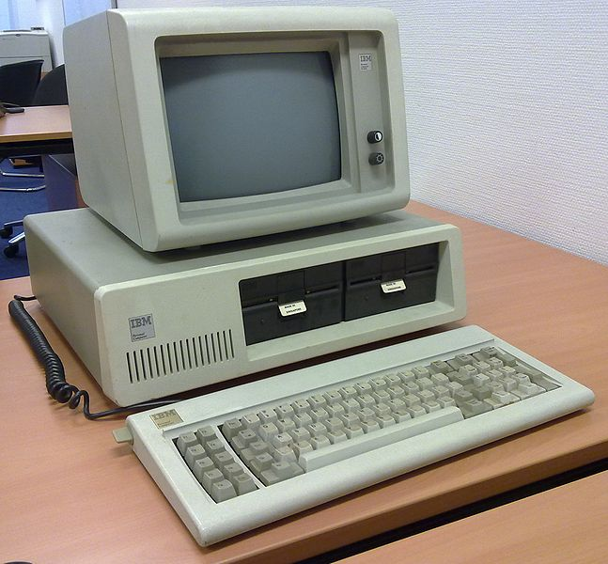
Long Long Ago…
IBM PC introduced on August 12, 1981
CGA: Color Graphics Adapter
First color computer display standard for IBM PC
16K video memory
Featured several graphics and
text modes
Highest resolution was 640*200
16 colors

Slide 13
Early Years of ATI
Lee Ka Lau, Benny Lau, and Kwok Yuen Ho(何国源) founded ATI (Array Technology Industry) in 1985
Worked primarily in the OEM field, producing integrated graphics cards
1987-1994
Introduced EGA Wonder and VGA Wonder graphics card product lines under its brand in 1987
Released other three generations of 2D graphics card: Mach8(1991), Mach32(1992), Mach64(1994)
Went public in 1993
Notes:
促使ATI成为一家图形产品公司的原因非常简单。他们3个人的全部积蓄总共只有300,000美元。据何国源分析，创建一家电脑公司需要一大笔资金，所以他们只能做一家图形产品公司。
主要涉足OEM（原始设备制造商）业务，为大型个人电脑制造商（如IBM）制造显示芯片。当时的个人电脑只有IBM和其它竞争者的整机销售，而且价值不菲，所有配件包括软件都不会单独零售，所以OEM是唯一的出路。
ATI发售EGA Wonder和VGA Wonder家族显卡。这些显卡功能都比IBM自身的显示装置好，EGA/VGA Wonder是一种能用于市场上任何一种图形界面、软件和显示器的单卡，为传统个人电脑提供了更高速的图像，由此引起了个人电脑制造商和用户的重视！
第一代的VGA Wonder可以把它称为是当时高性能的“独立显卡”能够提供更强的图形处理能力；第二代的Mach8优化Windows系统，减轻了CPU的负担；第三代 第四代集成了当时硬件解压卡的功能，因此大受欢迎。虽然都是2D显卡，但功能越来越强，将原本属于CPU的运算量交给了显卡处理，不但解放了CPU，而且让图形处理和视频播放性能大幅提高，从这里我们已经看到了显卡高度集成的特性！

Slide 14
1993 & 1994
No independent market of graphics chips
Graphics chips were integrated with audio chips
Jen-Hsun Huang(黄仁勋), Chris Malachowsky, Curtis Priem co-founded nVidia in 1993
Ross Smith, Gary Tarolli and Scott Sellers founded 3dfx in 1994
Notes:
英特尔刚刚推出80586，并给这个系列取名奔腾。这位芯片巨头当时最大的努力就是甩开AMD，至于图 形芯片还无暇顾及；SGI仍然只给一些工作站提供图形加速器；LSI Logi也尚未专做图形芯片；已经成立8年的ATI自己仍没什么产品，还在吃代工 (OEM)市场；Matrox尚未专做显卡；Rendition(1993年成立)以及后来掀起3D革命的3Dfx(1994年成立)尚未出生。连微软的 DOS系统都还尚未一统天下，更谈不上什么标准。
更何况，当时显卡与声卡集成在一起，尚未形成专门的独立芯片市场。可以说，图形芯片市场接近于一张白纸，白得连一个箭头都没有。黄仁勋认 为，这是领跑的绝好时机。
1993年1月，Nvidia正式成立。据说，黄仁勋还把第一天上班的时间定在2月17日，刚好是他30岁生日。不管是有意，还是巧合，黄 仁勋兑现了自己30岁成立自己公司的诺言。
在1993年进军图形芯片，这是一个非常大胆但算不上极具开创性的主意。据Bay Area公司图形芯片业的分析师乔恩 (Jon Peddie)回忆说：“当时黄仁勋还专门打电话，咨询关于图形芯片市场与未来的走势，我告诉他，这个市场上还没起步已经乱成一团了，现在已经 有将近30家公司，你最好别干这个。”

Slide 15
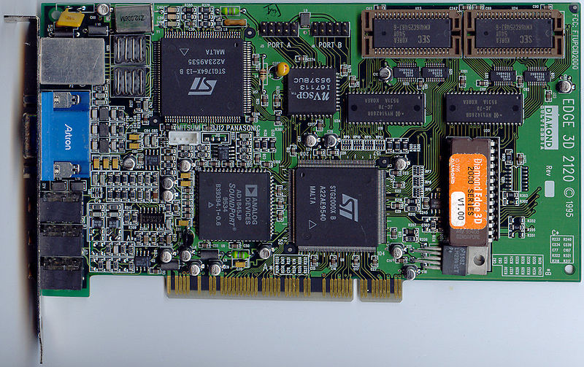
1995
nVidia released NV1
Featured a complete 2D/3D graphics core based upon Quadratic Texture Mapping(QTM)
Integrated graphics, audio and joystick
Credible 3D performances, but high-cost and poor overall quality

Slide 16
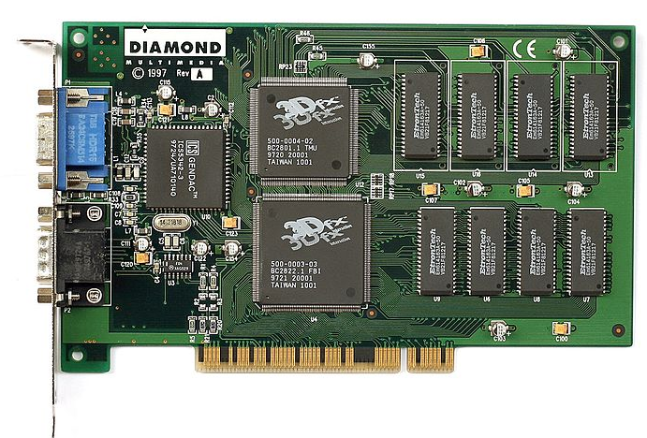
1996
3dfx released Voodoo Graphics chip
ATI released its first 3D graphics card: 3D Rage
nVidia announced supporting Microsoft Direct3D API
Microsoft wanted to contain 3dfx
Change technological direction from console to PC
Notes:
1996年3月，黄仁勋明确表示，Nvidia将完全支持微软 Direct 3D API标准，这在当时难能可贵。因为每家显示芯片公司都不想捧微软，非要搞自己的API，结果一家一个样。这种场面既令微软顾忌，也 令下游伙伴为难。
黄仁勋这一选择，为奄奄一息的Nvidia赢得广泛支持，尤其是受到微软垂青。一方面，作为行业领袖的微软始终要防范在某一细分领域出现一 家独大，与自己讨价还价。眼看着3Dfx就要垄断显示芯片市场，微软很想扶一个老二予以制衡。另一方面，微软很希望显示芯片业有人站出来，旗帜鲜明地推广 微软的标准。微软向Nvidia示好，众多下游厂商也乐意帮一把。
Nvidia还决定将主攻市场从游戏机改为个人电脑，这是Nvidia另一个革命性转弯，堪称 从一个极端走向另一个极端，事实证明，Nvidia这一步走对了。

Slide 17
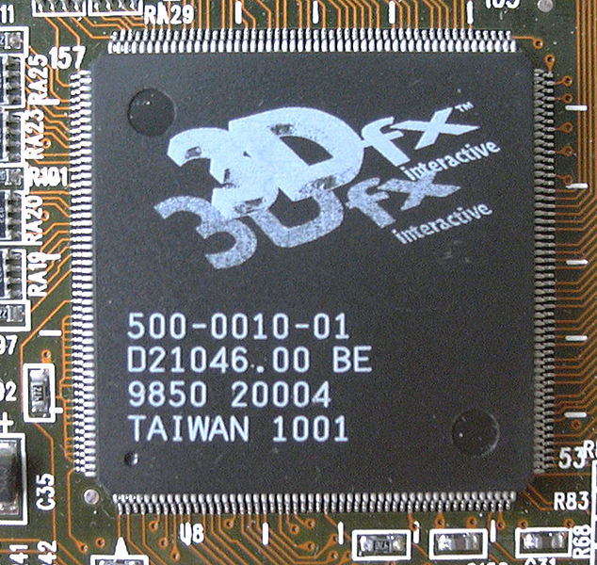
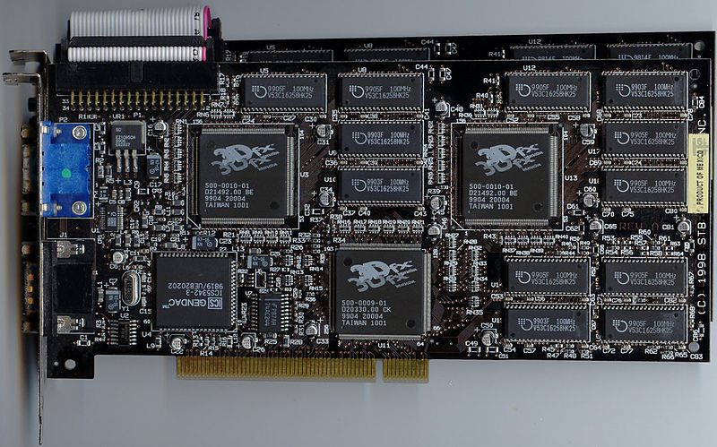
1998 1/2
3dfx released Voodoo2
Three graphics processing units on a single chipset
The only 3D card capable of single-cycle dual-texturing
Most games supported 3dfx's proprietary Glide API which gave Voodoo2 a large advantage in speed and image quality
Introduced Scan-Line Interleave (SLI)

Slide 18
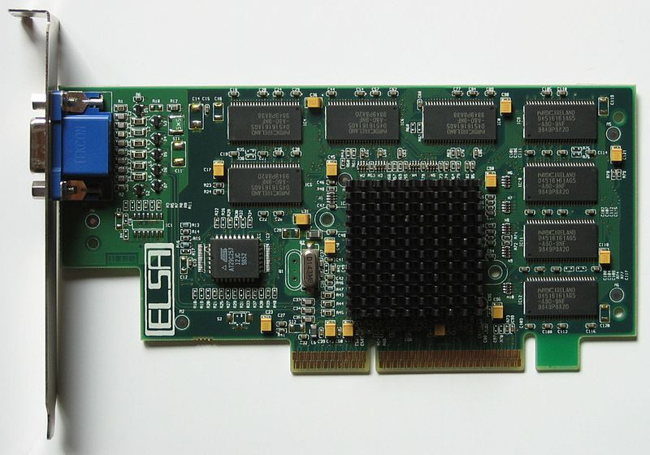
1998 1/2
nVidia released NV4 (RIVA TNT)
Response to Voodoo2
Cemented nNidia’s reputation as a worthy rival within 3D graphics adapter industry
Came close to Voodoo2 in performance in some games, and beaten it in 32bit image quality
Very successful drivers
Notes:
Nvidia's driver development with TNT was the beginning of their notably aggressive efforts to maintain the best set of drivers possible. TNT received the first branded driver within the industry, called Detonator.
These drivers were a huge success. While the TNT had always performed well on Intel based systems, it previously lagged behind in terms of performance on then current AMD based systems. At the time, Quake2 was the benchmark for performance and the 3dfx-made Voodoo2 enjoyed a large performance difference over the TNT because it had 3DNow! optimizations that negated the performance penalty of the weak, unpipelined FPU on then current AMD processors. The Detonator drivers included 3DNow! optimizations and the TNT's Quake2 performance jumped 30%. In fact, all OpenGL and DirectX applications benefitted from such optimizations. This made the TNT a much more attractive 3D accelerator for AMD owners than previously.
Riva TNT不仅有极快的速度，极好的画质，还有极高的稳定性。更值得称赞的是，Nvidia还特意开发出超强的驱动程序，使显示芯片 的功能尽情发挥，一改显示芯片业显卡强、驱动弱的局面，TNT彻底炸开了市场。
9月，Nvidia被《个人电脑杂志》评为最有影响力的显示芯片生产商，而TNT被 Mercury研究公司评为速度最快的显示芯片。戴尔也宣布电脑中集成Nvidia的TNT。此外，Nvidia还被OpenGL架构评论委员会吸纳为新 成员，从此与康柏、惠普、IBM、英特尔、微软等为伍，成为专业显示芯片厂商中获此殊荣的第一家。

Slide 19
1999 1/2
3dfx released Voodoo3
Purchased STB Technologies
Indented to start manufacturing, marketing and selling its own graphics cards, rather than functioning only as OEM supplier
Vastly different entities, never integrated smoothly
One of the main contributors to downfall
Expect to make 3dfx the undisputed leader but below expectation
Lacked 32-bit color and large texture support
Gave up market leadership to nVidia

Slide 20
1999 2/2
nVidia released GeForce 256
The original release in “GeForce” product-line
World‘s first GPU(Graphics Processing Unit)
Transform and Lighting (T&L) engine
Integrating T&L into GPU itself
Reducing hardware complexity and price consequently
Industry-leading real-time 3D rendering performance
Allowing nVidia entering CAD market with product named “Quadro”
The first fully Direct3D 7-compliant 3D accelerator
Notes:
1999年8月，Nvidia出人意料地结束了正在热卖的Riva系列，推出了全新的GeForce 256，成为全球第一款图形处理单元， 简称GPU。GeForce 256成为显示芯片业又一款革命性产品，它不仅是第一款256位的显示芯片，而且集成了2300万晶体管，比英特尔的奔3 还多一倍；每秒最少能处理1000万多边形，速度之快前所未有，开创了个人电脑业即时的图形显示标准。
当英特尔试图将所有功能都集成到一个平台上时，GPU的出现打破了英特尔的集成构想，使显示芯片成为一个真正独立的市场，
Nvidia吸取了以前的教训，GPU不仅支持微软已经升级的Direct3D 7.0 API标准，而且配以支持 Windows 2000与Windows NT的ICD的驱动，结果大获成功。
1999年8月31日，GPU正式面市，个人电脑业各大巨头，包括戴尔、Gateway、康柏及NEC都当天宣布将预装Nvidia的 GPU，IBM次日加盟。当天，六大显卡生产商也明确表示，加入Nvidia阵营。
GPU一出场就直接占领了主流市场。而两个月后，Nvidia更进一步，推出面向工作站的GPU，即Quadro系列，从而既牢牢控制了显 示芯片业的技术制高点，而且继个人电脑市场之后，成功打开工作站市场。

Slide 21
2000
nVidia acquired 3dfx
nVidia released Geforce2 (NV15)
ATI released Radeon R100
Notes:
从当年4月发布第二代GPU开始，接下来7个月连续推出6款产品，而且各有突破，各有专攻，在整个 芯片史上都前所未有，所有对手阵脚大乱，纷纷下台。
用分析师彼特(Peter Labe)2001年的话说：“几年前，我们至少要研究10家公司，到2000年，全被Nvidia挤破产了， 整个市场只剩下ATI奄奄一息，英特尔如临大敌。”

Slide 22
2002
Conflicts between Microsoft and nVidia
nVidia denied to decrease GPU price for Xbox
Microsoft gave GPU order of its next generation of Xbox to ATI
Intel supported ATI to compete with nVidia
Microsoft + Intel + ATI vs. nVidia
Share price of nVidia dropped from $70 to $7

Slide 23
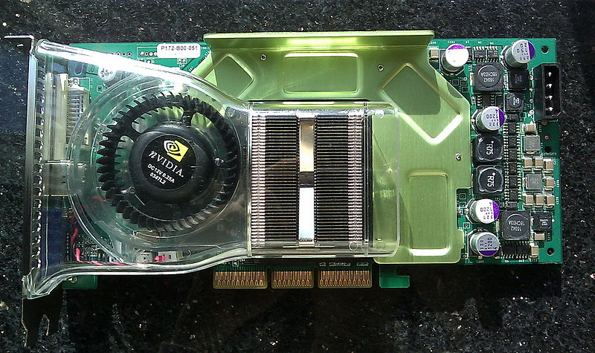
2003
nVidia released GeForce FX
Weak performance for processing Shader Model 2 programs
The most failed product in nVidia’s history
nVidia resolved issues with Microsoft
nVidia started cooperation with Intel
Notes:
黄仁勋主动找微软谈判，并于2003年2月与微软达成和解。之后，2003年5月，Nvidia再次与微软达成合作，微软 MCE媒体播放器软件将搭售Nvidia图形芯片。而2003年Nvidia之所以渡过难关，还与Xbox走向热销直接带动Nvidia收入增长不无关 系。
黄仁勋很快认识到，英特尔毕竟是英特尔。在英特尔对ATI扶持下，不管 Nvidia推出新品速度多快(再次用半年多时间推出6款新品)，ATI总能赶上，而且从高中低档全面反击，以Nvidia之道还治Nvidia。结果， 整个2003年，Nvidia的市场份额时有下滑。
重现惊人的产品更新速度，虽然未能推出革命性产品，但借助 NV35，尤其是GeForce FX 5900 Ultra，重新夺得了技术领先地位。同时通过下半年在中低端产品市场的出击，阻止了市场份额的下滑势 头。
此外，通过收购MediaQ，成功打入增长性极好的手持设备显示芯片市场。所以Nvidia全年收入达到18亿美元，表现并不差。
为了挽回FX5800的败局，NV改进核心架构推出了FX5900显卡，虽然显存升级到256Bit让性能提高不少，然而核心架构缺陷让它无法抵挡高频率9800系列的攻势，之后的5950Ultra也在9800XT面前无能为力！虽然9800在架构上并没有太多的改进，制造工艺依然维持0.15微米（之后高频的9800XT还是0.15微米），但频率的提高让它的性能比9700更上一层楼，SmartShader2.1和SmoothVision 2.1可能就是为数不多的改进了。

Slide 24
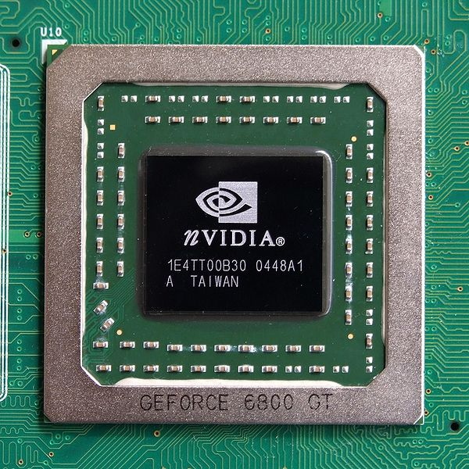
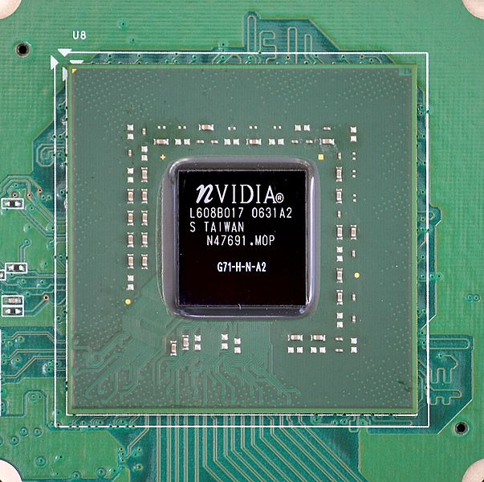
2004-2006 1/2
nVidia released GeForce 6 & 7 series
Introduced SLI technology
Compliant with Direct 9.0c and Shader Model 3.0

Slide 25
2004-2006 2/2
ATI released R420 & R520
Kwok Yuen Ho resigned as ATI CEO in face of OSC probe
He and other ATI insiders, including his wife, Betty, are accused of avoiding losses of $7.9-million by selling company stock before a December, 2000,
Notes:
9700/9800让ATI沉浸在了成功的喜悦之中，推出了架构上并没有太大变化的X800系列，像素管线翻倍提升至16条，性能提升非常显著。而NVIDIA经历FX系列的失败之后，卧薪尝胆推出了规格先进的6800系列产品，规格与X800系列极其相似同样为16管线6顶点的配置。 然而令ATI始料未及的是GeForce 6系列完全按照DirectX 9.0c SM3.0的标准设计，而X800系列仅支持DirectX 9.0b SM2.0b，虽然当时并没有多少游戏能够支持SM3.0和HDR，但这已经让X800系列失去了上代9700的王者风范！
而急于扳回一城的ATI却连续遇上了功耗等不利因素造成的Re-tape，导致传说中的R520一再跳票。经过了4个月痛苦的G70 VS nothing的煎熬，R520终于在10月发布。

Slide 26
2006-2007 1/2
nVidia released GeForce 8
The first fully Direct3D 10-capable consumer graphics chip
Introduced first unified shader architecture
Major shift for nVidia in GPU functionality and capability
Introduced CUDA (Compute Unified Device Architecture)
GPU evolved from graphics computation to general computation

Slide 27
2006-2007 2/2
ATI released Radeon R600
Acquired by AMD in 2006
$5.4 billion
ATI’s operations were folded into AMD Graphics Product Group
ATI’s position
Preparing for the inevitable confrontation with Intel
Competing with NVIDIA is tough, this makes it easier
The Manufacturing & Design Advantage
AMD’s position
Merging CPU and GPU together to compete with Intel
Notes:
Preparing for the Inevitable Confrontation with Intel
From ATI's standpoint, it's only a matter of time before the GPU becomes general purpose enough that it could be designed and manufactured by a CPU maker. Taking the concern one step further, ATI's worried that in the coming years Intel will introduce its standalone GPU and really turn up the heat on the remaining independent GPU makers. By partnering with AMD, ATI believes that it would be better prepared for what it believes is the inevitable confrontation with Intel. From ATI's perspective, Intel is too strong in CPU design, manufacturing and marketing to compete against when the inevitable move into the GPU space occurs.
Competing with NVIDIA is Tough, this Makes it Easier
It's no surprise to anyone that competing with NVIDIA isn't easy; the easiest time ATI had competing with NVIDIA in recent history was back during the Radeon 9700 Pro days, but since then NVIDIA has really turned up the heat and currently enjoys greater desktop market share. Not only does it have greater desktop market share, but NVIDIA also enjoys greater profit margins per GPU sold thanks to smaller die sizes. By being acquired by AMD, ATI gets a bit of relief from the competition with NVIDIA, as well as some potential advantages. Those advantages include the potential to build and execute better AMD chipsets as well as gaining greater overall graphics market share by shipping more platforms with integrated graphics (either on CPU or on chipset). Intel is actually the world's largest graphics manufacturer, since the vast majority of Intel systems sold ship with some form of Intel integrated graphics; through this acquisition, AMD can use ATI to do the same, which should increase ATI's overall market share.
Making Better AMD Chipsets
ATI has struggled to design, manufacture and execute a chipset that could compete with NVIDIA's nForce line. To date, ATI has come close but not been able to close the deal and it has been trying for years. In theory, with better access to AMD engineers and designers, being able to leverage AMD's IP (e.g. CrossFire implemented over Hyper Transport) and eventually being able to use AMD's fabs, ATI could design a truly competitive platform for AMD processors. As long as the product is decent, AMD would also be able to significantly increase sales by simply offering attractive platform bundles similar to what Intel does today. Whether the approach is more similar to Centrino where AMD requires that you purchase only AMD silicon, or more like how Intel does business on the desktop side where AMD makes sure that only its chipsets are available at launch has yet to be seen.
The Manufacturing & Design Advantage
Currently both ATI and NVIDIA have to turn to third party manufacturers to produce both their chipsets and GPUs. If this acquisition were to go through, AMD could eventually begin manufacturing some chipsets or GPUs for ATI. By manufacturing components in house, ATI would be able to enjoy a cost advantage over competing NVIDIA products (especially if ATI is simply using leftover capacity at older fabs that are awaiting transition to smaller manufacturing processes). ATI could potentially begin to release GPUs using newer process technologies before the competition as well, reducing die size and increasing clock speeds at the same time.
Manufacturing aside, there's also this idea that companies like AMD and Intel are better at designing silicon because they work on a more granular level with the design. There's far more custom logic in Intel's Core 2 Duo than in NVIDIA's GeForce 7900 GTX; ATI would gain access to AMD's entire portfolio of custom logic and may be able to implement some of it in its upcoming GPUs, giving ATI a performance and efficiency advantage over NVIDIA.

Slide 28
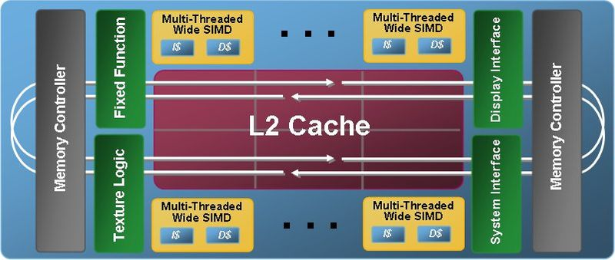
2007
Intel announced its Larrabee GPU project
Considered a hybrid between multi-core CPU and GPU
CPU-like: coherent cache and x86 architecture
GPU-like: wide SIMD vector units and texture sampling hardware
Cancelled in 2010

Slide 29
Keys to High Perf. Computing
Efficient computation
Efficient communication
Simply providing large amounts of computation is not sufficient
Processing elements often spend most of the time waiting for data

Slide 30
Efficient Computation
Use of transistors can be divided to three categories:
Control: direct the computation
Compute: perform computation
Storage: store data
Devote most of transistors to compute hardware rather than control hardware
Exploit parallelism
Task parallelism
Data parallelism
Instruction parallelism

Slide 31
CPU/GPU Parallelism
Moore’s Law provides more and more transistors, how to utilize them?
CPU: make one compute thread run as fast as possible
Cache
Instruction/Data prefetch
Hyperthreading
…then add task parallelism…Multi-core
GPU: make as many threads as possible
1000s of threads
Pipelining

Slide 32
Stream Programming Model
Allows high efficiency in computation and communication
Basis for programming GPUs today
All data is represented as a stream
Kernels: operations on streams
Applications are constructed by chaining multiple kernels together

Slide 33
Kernel
Operates on entire streams of elements and produces a new stream
Within a kernel, computations on one stream element are never dependant on computations on another element
Fits perfectly onto data-parallel hardware

Slide 34
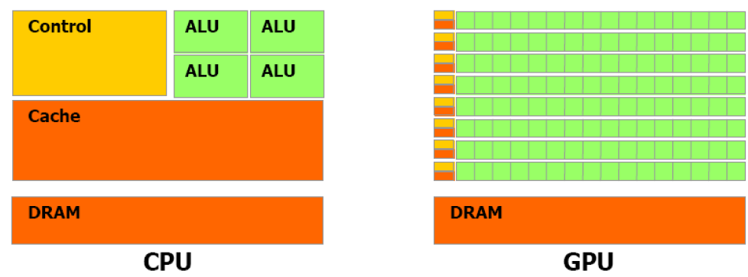
Data-Stream-Based (GPU)
Uses only small caches and devotes the majority of transistors to computation
Notes:
The DSB model separates the two tasks of configuring the PEs and controlling the data-flow to and from the PEs. By contrast, an instruction prescribes both the operation to be executed and the required data. The separation of tasks deals much better with the memory gap problem, because the individual elements of the data streams can be assembled from memory before the actual processing. This allows the optimization of the memory access patterns, minimizing latencies and maximizing the sustained bandwidth. In ISB architectures only a limited prefetch of the input data can occur, as jumps are expected in the instruction stream. By contrast, it is inherent in the DSB model that no such jumps will occur for a long time. Thus, the resources can be concentrated on efficient data retrieval and parallel processing rather than jump predictions and speculative execution. Clearly, the advantage applies only to algorithms that exhibit this kind of regular behavior. Therefore, for some irregular algorithms, it is advantageous to increase the operation count in favor of more regular behavior, and thus faster execution, on DSB hardware.

Slide 35
Instruction-Stream-Based (CPU)
Prescribes both the operation to be executed and the required data
Only a limited prefetch of the input data can occur
L2 cache consumes most of the transistors in CPU

Slide 36
Comparison: Example
Adding up two arrays containing 100 4-component vectors
Conventional, sequential paradigm
Parallel Stream paradigm
for (int i=0; i<100*4; i++)
result[i] = source0[i] + source1[i]
streamElmentFormat 4 numbers
streamElments 100
elementKernel “@arg0+@arg1”
result = kernel(source0, source1)
Notes:
As you can see, the idea is to define the whole set of data instead of each single block. Describing the set of data is assumed to be in the first two rows. After that, the result is inferred from the sources and kernel.

Slide 37
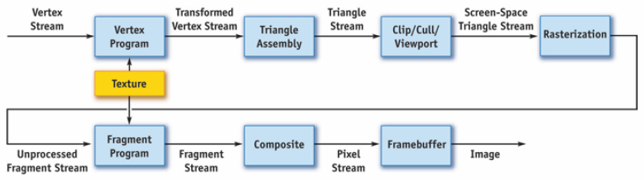
Mapping Pipeline to Stream Model
The stream formulation of the graphics pipeline
All data as streams
All computation as kernels
Both user-programmable and nonprogrammable stages can be expressed as kernels

Slide 38
GPGPU
GPGPU: General-Purpose computations on GPUs
Increasing programmability of modern GPUs are capable of performing more than graphics computation
Many successful applications:
Replace CPUs with GPUs?
Merge CPU and GPU together?

Slide 39
GPGPU Applications
Database
Relational joins on GPUs
High performance sorting
Data visualization and mining
Audio signal processing
Fast Fourier transform
Bioinformatics
Image processing and computer vision
……

Slide 40
GPGPU Implementations
Convert general-purpose computing to graphics problem:
Data -> Images
Algorithms -> Image synthesis
GPU can only be programmed through graphics API

Slide 41
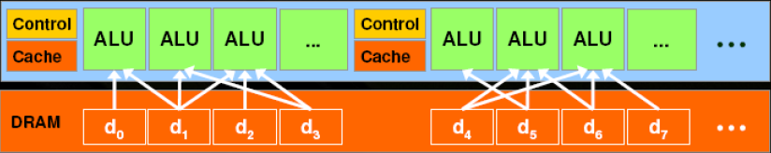
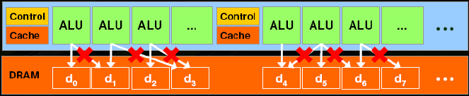
GPGPU Drawbacks (1/2)
It is a tough work for those outside graphics to convert general-purpose computing to graphics computing
Memory model: GPU is capable of gathering data from any part of DRAM, but can not scatter data to any part of DRAM
Only gather
No scatter

Slide 42
GPGPU Drawbacks (2/2)
Fragment shader
Fixed output addresses, no general scattering
Fragment can not communicate with each other

Slide 43
GPU Computing
CUDA: Compute Unified Device Architecture
New software architecture for managing computations on GPU
No need of mapping computations to graphics APIs
Extension to C
OpenCL : Open Computing Language
Supports parallel execution on single or multiple processors
GPU, CPU, GPU+CPU or multiple GPUs
Designed to work with graphics APIs such as OpenGL

Slide 44
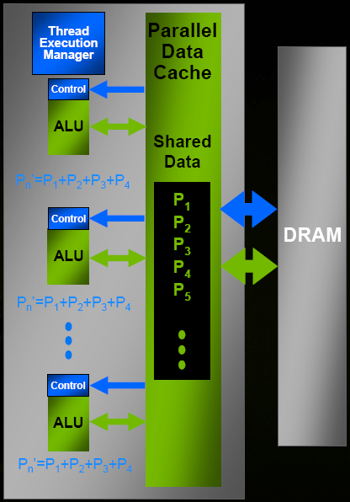
Parallel Data Cache
On-chip shared memory with very fast general read and write access
Threads share data with each other for inter-thread communication
Addresses a fundamental problem of stream computing
Bring data closer to ALU
Stage computation through shared memory
Minimize trips to external memory
Share values to minimize overfetch and computation
Increases arithmetic intensity

Slide 45
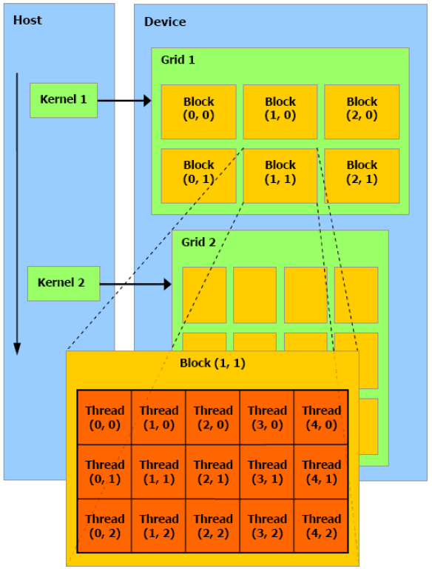
Thread Organization
A kernel is executed as a grid of thread blocks
Three levels structure
Thread
Thread block
Grid of thread block

Slide 46
A Massively Parallel Coprocessor
GPU is viewed as a compute device that
Is a coprocessor to CPU
Has its own DRAM
Runs thousands of threads in parallel
Data-parallel portions of an application execute on the device as kernels which run many cooperative threads in parallel
Differences between GPU and CPU threads
GPU threads are extremely lightweight, very little creation overhead
GPU needs thousands of threads for full efficiency, CPU needs only a few
Threads are non-persistent

Slide 47
Applications
Computer graphics
Advanced mapping techniques
Global illumination
Fluid simulation
Image Processing
Filters
Medical visualization
Segmentation
Image registration

Slide 48
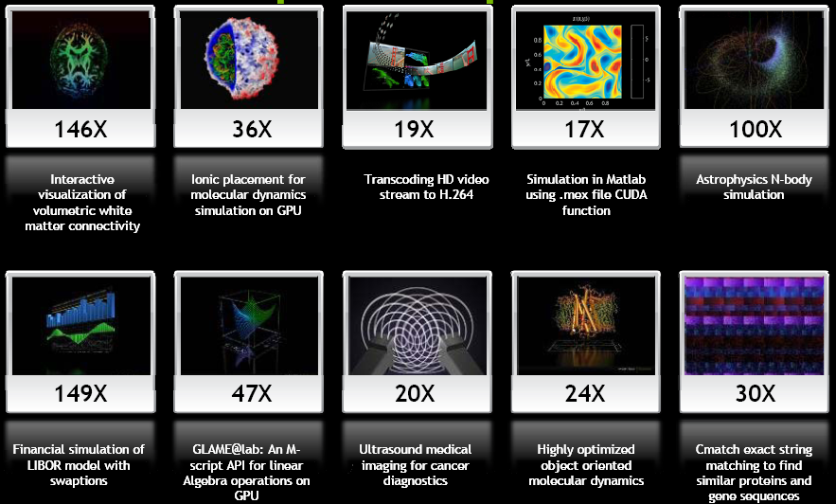
Wide Developer Acceptance

Slide 49
Faster Is Not "just Faster"
2-3X faster is “just faster”
Do a little more, wait a little less
Doesn’t change how you work
5-10x faster is “significant”
Worth upgrading
Worth re-writing (parts of) the application
100x+ faster is “fundamentally different”
Worth considering a new platform
Worth re-architecting the application
Makes new applications possible
Drives “time to discovery” and creates fundamental changes in Science

Slide 50
Image Processing on GPUs
IP tasks are computationally intensive
Real-time computing is one of the most important requirements for many applications
Special-purpose hardware is rarely found
CPU is not fast enough
GPU is common hardware found on most PC and much faster than CPU

Slide 51
Implementation Framework
Many operations can be considered sequences of filtering operations
These filter operations can be carried out by fragment programs on GPU
Input images are initialized as textures and mapped onto quadrilaterals
Render these quadrilaterals to invoke fragment programs

Slide 52
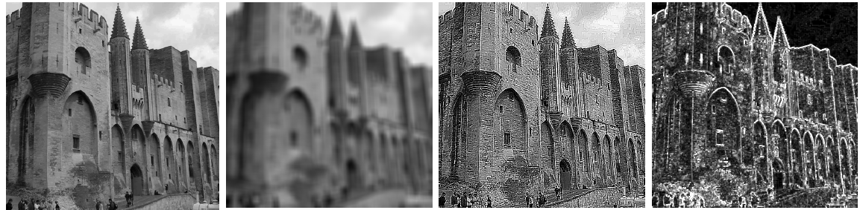
2D/3D Filters on GPU
Common filters
GPU is up to 149x faster than CPU for equivalent implementation

Slide 53
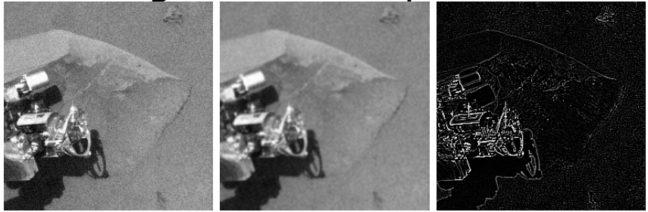
Averaging and Edge Filters
Valuable in image processing/computer vision
Simple matrix operations
Convolutions –multiply each pixel’s neighborhood by a mask

Slide 54
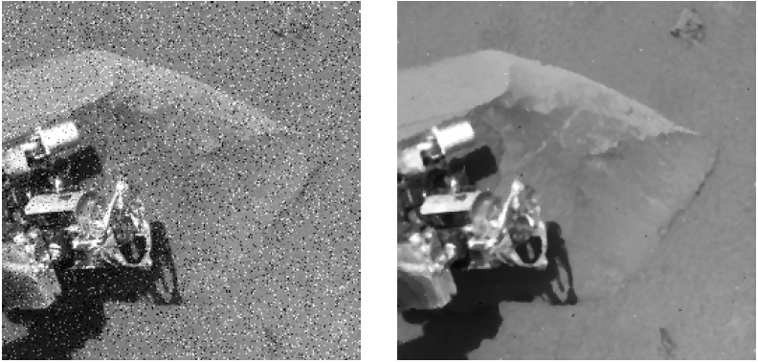
Median Filters
Replaces a pixel by the median value in its neighborhood mask
GPU implementation is 10x faster

Slide 55
Morphological Operations
Morphological operators change the shape, or morphology, of regions in an input image
Erosion and Dilation are the two primary morphological operators
Erosion removes one pixel from the boundary of each region
Dilation makes each region one pixel wider in radius
GPU implementations are ~20x faster than CPU

Slide 56
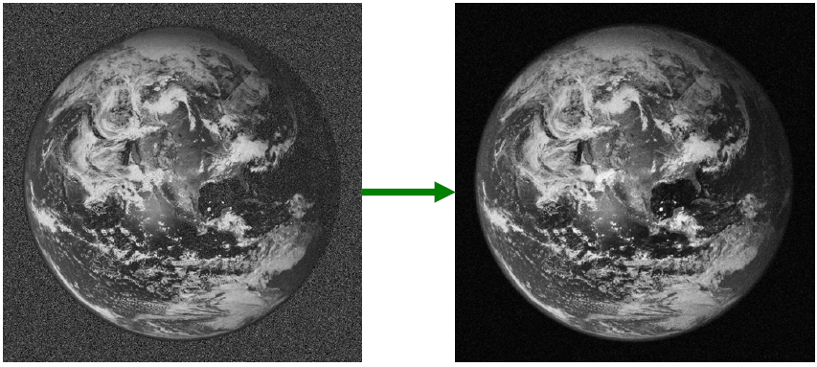
Gaussian Smoothing
CPU version of “naïve” algorithm is 60x slower than GPU algorithm at 2048x2048
Even optimized with FFT, the CPU is 9-12x slower than the GPU

